Slide 1
,, Forests in Poland and Europe.
Characteristics and management”

Slide 2
Bieszczady National Park and protected areas

Slide 3
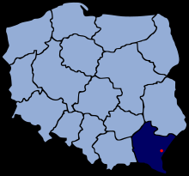
This project is about Bieszczady National Park and about protected areas near the city of Przemyśl. In this project we want to describe protected animals and plants in the park and on the protected areas.

Slide 4
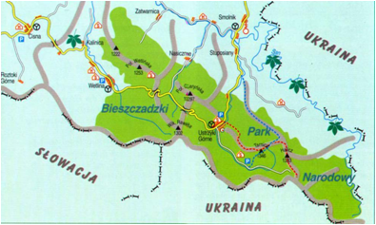
Bieszczady National Park is the third biggest national park in Poland. When it opened in 1973 it encompassed Tarnica, Krzemionka and Halicz with a surface area of 59,55km². The area of the park has been enlarged four times in 1989, 1991, 1996 and in 1999. Currently its territory is 29202ha. It is the biggest mountain park in Poland. Now within its borders there are huge parts of the Polish High Bieszczady. In 1992 it became part of the International Biosphere Reserve "Eastern Carpathians". Bieszczady National Park takes up the south-eastern part of the podkarpacki province. Within its area is the most southern point of Poland, peak Opołonek (1028 m above the sea level), which is situated at the border with Ukraine. The lynx is the coat of arms of Bieszczady National Park.

Slide 5
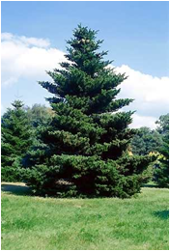
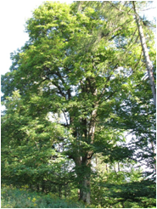
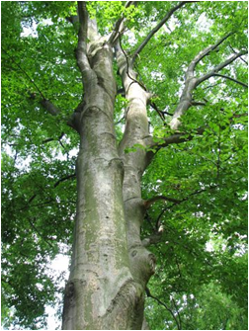
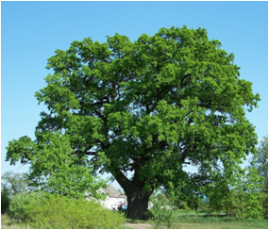
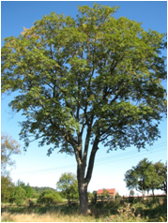
Bieszczady National Park protects the highest areas of the Polish region of the Eastern Carpathians. In the Park there are two plant-climatic levels. Natural deciduous and mixed forests occupy 80% of the area, out of which 15% is regarded as forest tree stands of primitive character. Highly protected areas constitute about 63% of the area. It is the highest percentage of all the national parks in Poland.

Slide 6
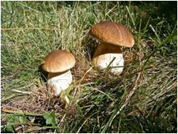
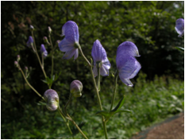
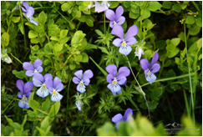
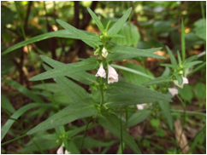
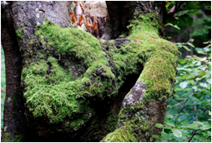
In Bieszczady National Park there are numerous species of plants: 250 mosses, 500 lichens, 1000 mushrooms, 780 vascular plants and 30 plant species of Eastern Carpathian, found only in the park. At 1150-1250 meters above the sea level there is an area of Eastern Carpathian called the "mountain pastures", which is unique to Poland and covers an area of 1800 ha. Almost 90% of this area comes under strict protection. There is a variety of plants, not found anywhere else in Poland. In early spring you can find a lot of spring snowflakes there. One type is very special as it has two flowers on the stem not just one.

Slide 7
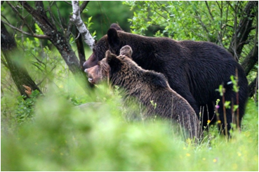
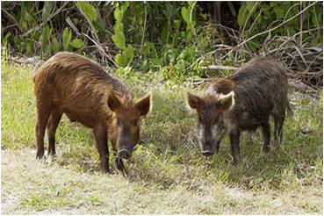
In this park there are 230 species of vertebrates, including 58 species of mammals. Within its borders you can find almost all domestic species of big predatory mammals, such as: bears, wolves, lynxes and wild cats. You can also find herbivorous, such as the European bison and Carpathian deer. In the 1960s. about 20 European bison were brought to the Bieszczady mountains from farming centres in Pszczyna and Niepołomice. These animals adapted to the new habitat and currently their numbers have reached 280, of which a few dozen live in the park. It is the largest wild mountain herd of these animals in the world.

Slide 8
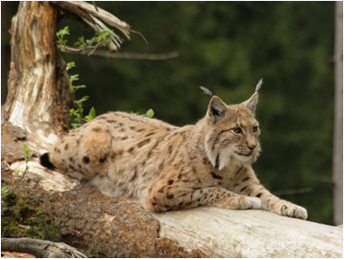
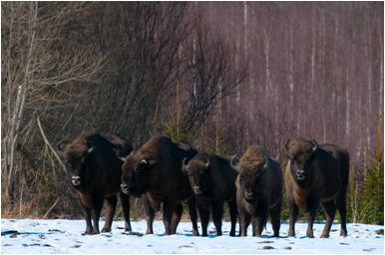
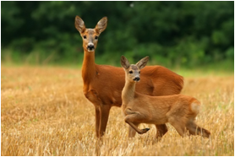
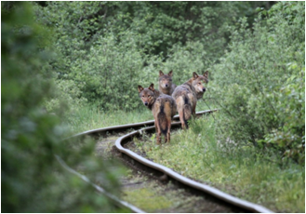
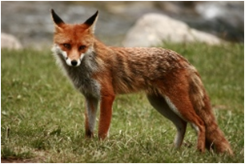

Slide 9
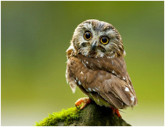
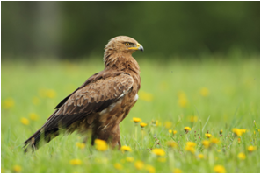
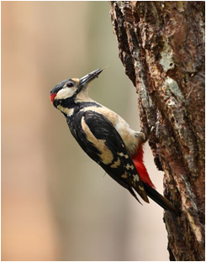
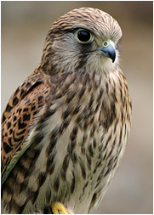
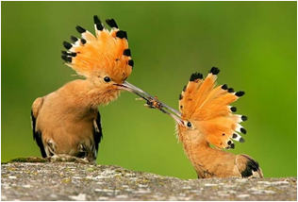
In Bieszczady National Park are 140 species of breeding birds , for example many rare birds of prey. You can also find many rare domestic kinds of owls and protected species of woodpeckers which were added to the list of the "Polish Red Book of Animals". In the highest areas of the Park it is possible to see the rare species of mountain birds.

Slide 10
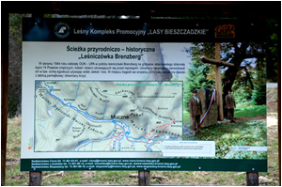
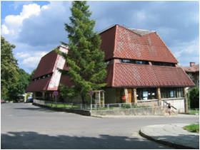
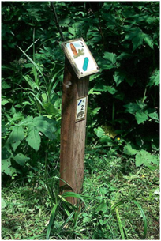
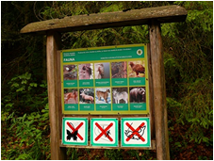

Slide 11
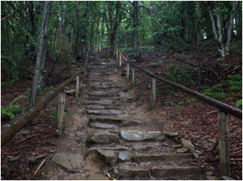
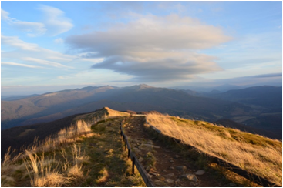
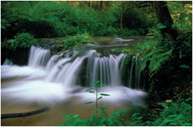
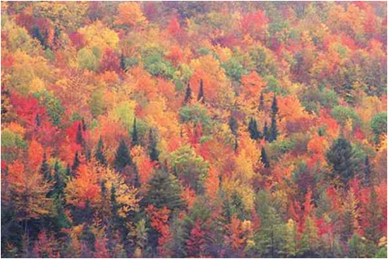
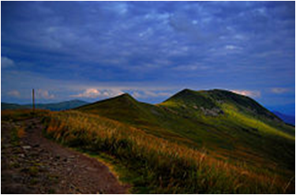

Slide 12
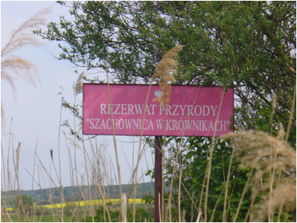
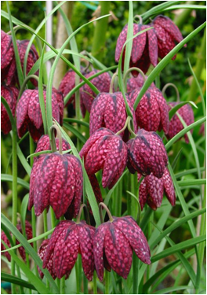
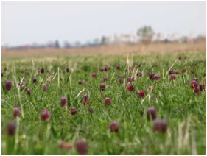
Near Przemyśl there is the small village of Krówniki. You can find Fritillaria meleagris ther , which is a beautiful plant. The flower has a checkered pattern of shades of purple or sometimes it is pure white. It blooms from March till May and grows between 15-40 cm in height. The plant has a button-shaped bulb, about 2 cm in diameter, containing poisonous alkaloids. It grows in grasslands in damp soils and river meadows at altitudes of up to 800 m and grows in smaller groups of a few but no more than a dozen plants.

Slide 13
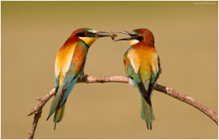
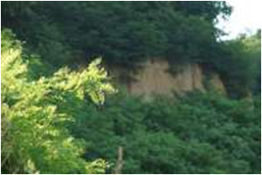
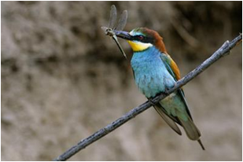
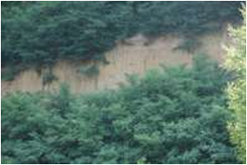
Near Krówniki there is a village Jaksmanice. There are birds. It is very elegant, colorful, rarely occurring.
The most breeding pairs ere appering on Podkarpacie neat the city Przemyśl. Favourite food is wasps and bees. They are found in smaller or bigger settlements on areas little afforested in sandy precipices created both natural and artificial

Slide 14
Bibliografia
Wikipedia.org
rezerwaty-podkarpackie.pl
bdpn.pl
,,Bieszczadzki Park Narodowy” Paweł Wroński

Slide 15
Karolina Kluz If
Katarzyna Flak If
Wiktoria Tomczak If
Zespół Szkół Elektronicznych i Ogólnokształcących im. prof. Janusza Groszkowskiego w Przemyślu

